Slide 1
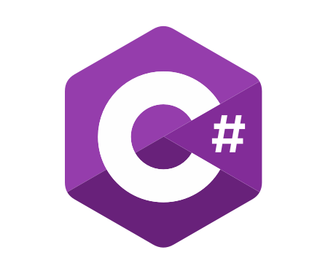
C# Fundamentals
Course Introduction
SoftUni Team
Technical Trainers
Software University
https://softuni.bg/

Slide 2
Table of Contents
Course Objectives
Training and Team
Course Organization
Course Infrastructure
Evaluation Criteria

Slide 3
Have a Question?
sli.do
#fund-csharp

Slide 4












SoftUni Diamond Partners

Slide 5


Educational Partners

Slide 6

Course Objectives

Slide 7
C# Fundamentals Objectives
Working with linear data structures
Arrays and Lists
Defining simple classes
Processing and manipulating strings
Regular expressions
Building а simple web project

Slide 8
Practical Programming Exam
Mid Exam
3 practical problems for 4 hours
Conditional Statements and Loops
Arrays
Lists
Final Exam
3 practical problems for 4 hours
Associative Arrays
Strings and Text Processing
Regular Expressions

Slide 9
Theoretical Exam
You will have 30 minutes once you start
Multiple choice with 1 or more correct answers
English
Automated quiz system
Available during the practical exam and 30 minutes after it
You can submit your answers just one time
Advice: Start it when you finish the practical exam

Slide 10

Course Organization

Slide 11
C# Fundamentals Module
16-May-2022
26-Jun-2022
7-Aug-2022
11-Aug-2022
15-Aug-2022
C# Fundamentals
12 weeks * 3 times / week 12 credits
Start: 16-May-2022
Mid Exam: 26-Jun-2022
Theoretical Exam: 7-Aug-2022
Final exam: 7-Aug-2022
Retake Exams
Mid Exam Retake: 11-Aug-2022
Тheoretical Exam: 15-Aug-2022
Final Exam Retake : 15-Aug-2022

Slide 12

Homework Assignments & Exercises
Your homework is mainly work in class
Lesson days → slides + live demos + exercises
Exercise days → only exercises
How to submit your homework?
Submitted in the judge system
Do your homework when it's due
Assignments pile up quickly

Slide 13
Course Scoring
Practice grade:
Theory grade:
SoftUni Certificate: 5.00 from Practice
CPE Certificate: 3.00 average from Practice + Theory
Practical Mid Exam
Practical Final Exam
Homework
40 %
60 %
+5 %
Theoretical Exam
100 %
13

Slide 14

The Team

Slide 15
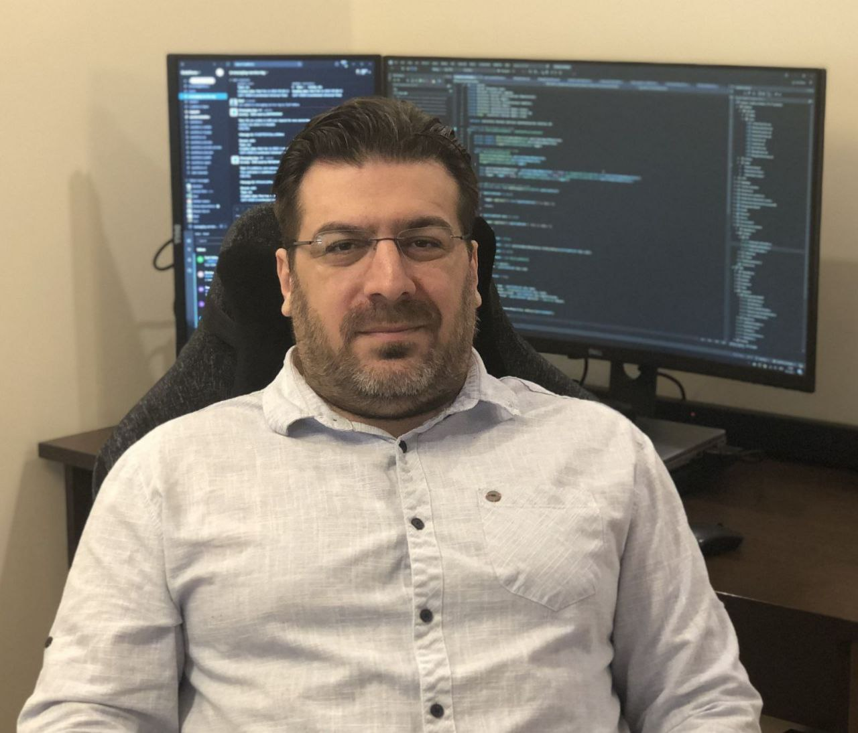
Georgi Inkov
C# Web Developer
8 years experience in .NET ecosystem
Graduated the first class @ SoftUni
Worked in Cashwave, Vivacom & Fourth
Now works as a back-end developer
@ ScaleForce (part of Excitel)

Slide 16
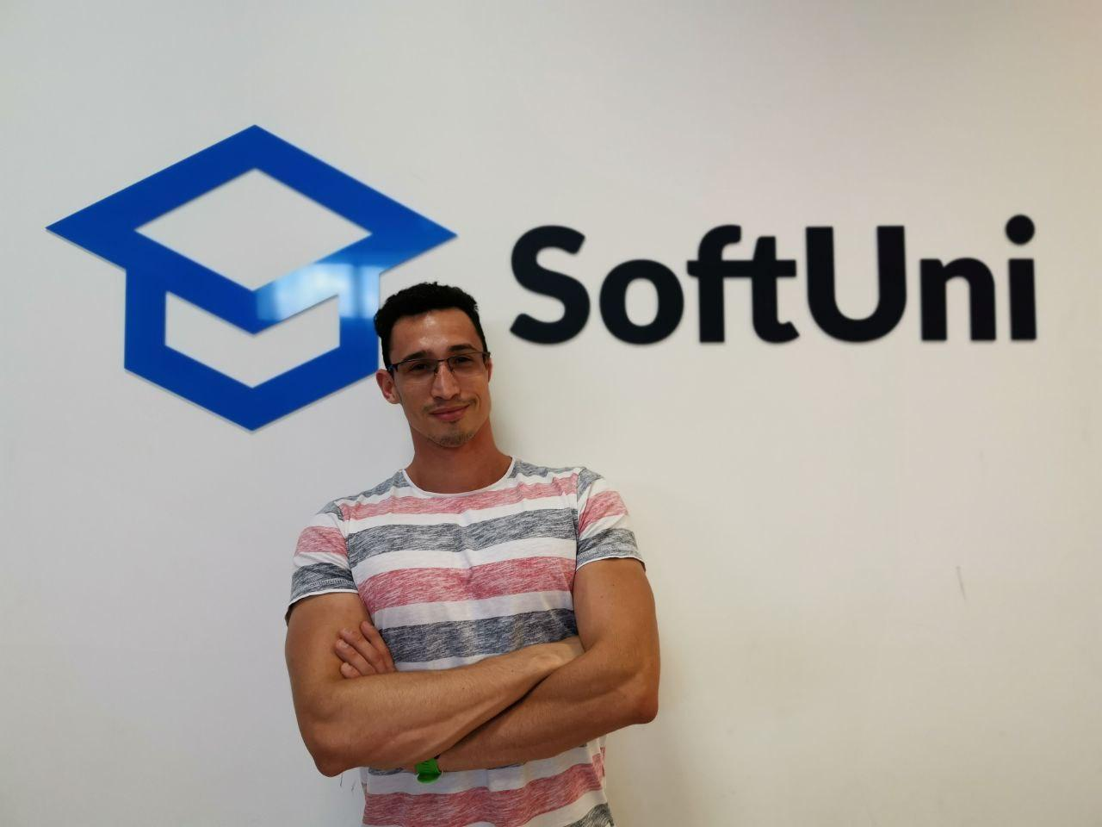
Dimitar Krastanov
Trainer @ SoftUni (JS and C#)
JavaScript Developer @ Mobile
Wave Solutions
Graduated from NSA
Interested in .NET, C#, Python, JS
Works with JS, ReactJS, TypeScript

Slide 17



Course Web Site, Forum and FB Group
Official web site:
Official discussion forum:
C# Fundamentals Facebook group:
https://softuni.bg/trainings/3729/programming-fundamentals-with-csharp-may-2022
softuni.bg/forum/categories/44
https://www.facebook.com/groups/ProgrammingFundamentalswithCsharpMay2022

Slide 18
Questions?
Notes:
18

Slide 19
Trainings @ Software University (SoftUni)
Software University – High-Quality Education, Profession and Job for Software Developers
softuni.bg, about.softuni.bg
Software University Foundation
softuni.foundation
Software University @ Facebook
facebook.com/SoftwareUniversity
Software University Forums
forum.softuni.bg
Notes:
19

Slide 20

License
This course (slides, examples, demos, exercises, homework, documents, videos and other assets) is copyrighted content
Unauthorized copy, reproduction or use is illegal
© SoftUni – https://about.softuni.bg/
© Software University – https://softuni.bg
Notes:
20

